Slide 1

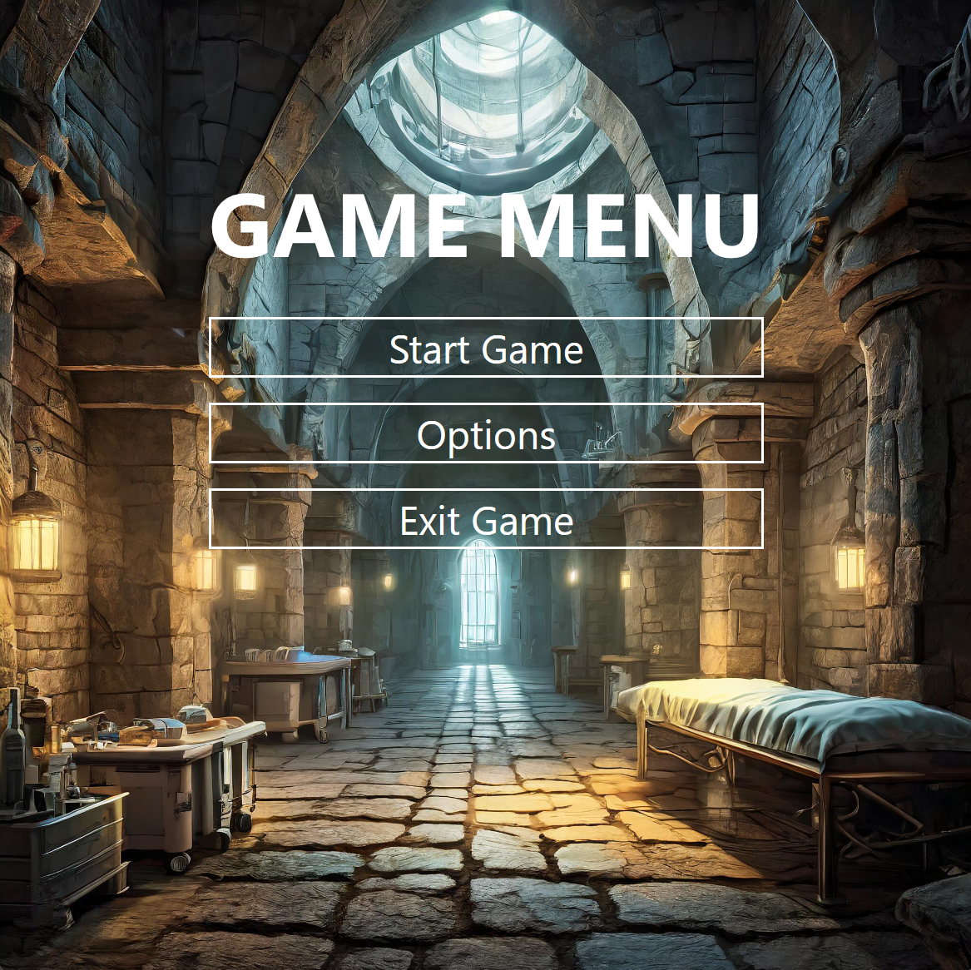
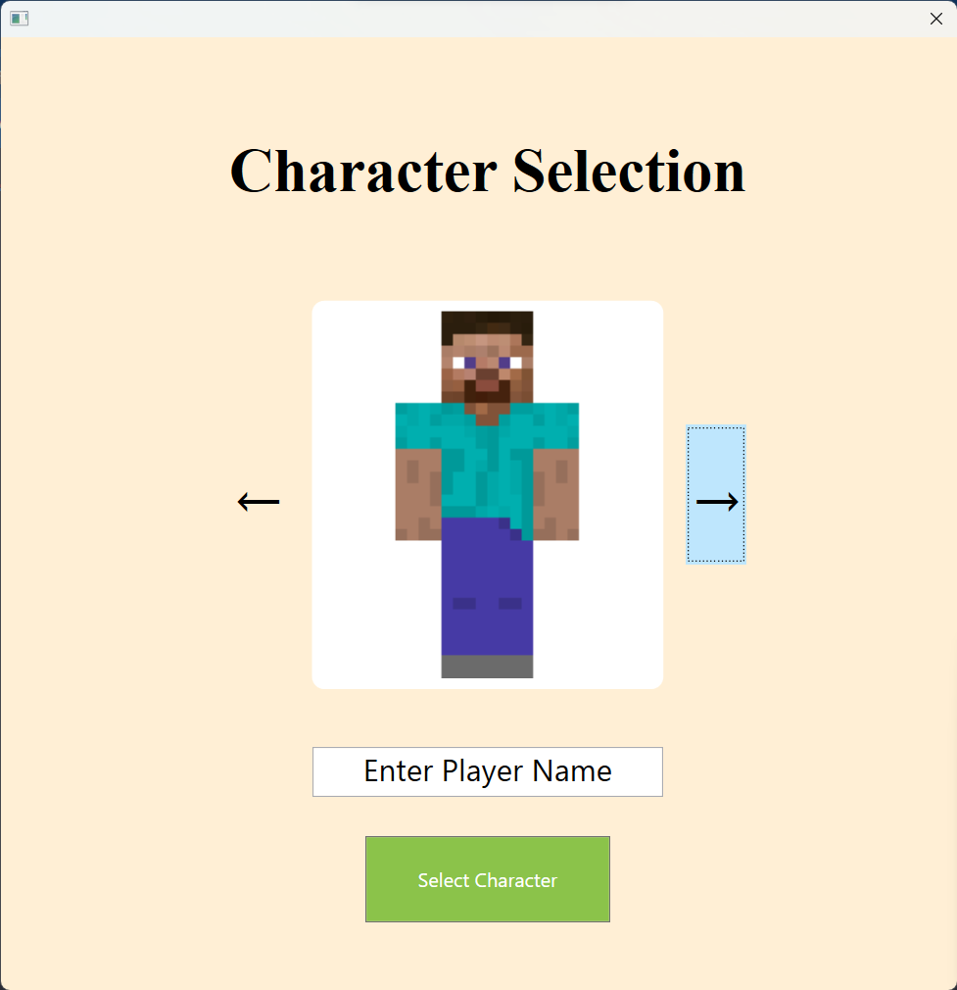
Maze
By: Ethan Gore, Fabian Gomez & Matheus Silva

Slide 2
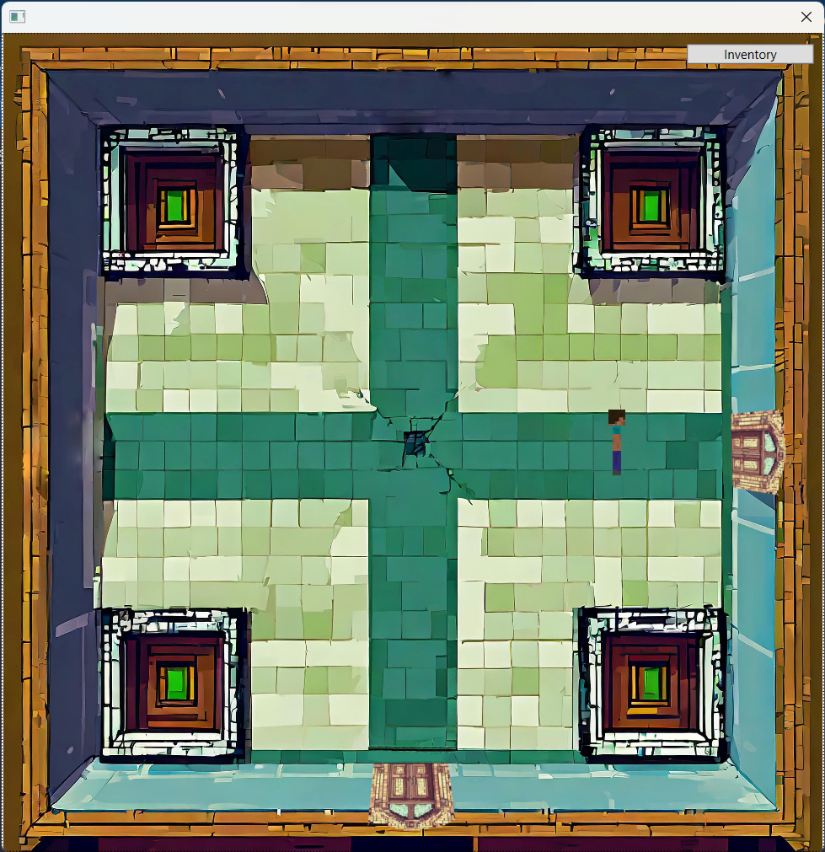
Introduction
User goes through rooms fighting enemies
Searching for a key to get to Scalibur
To defeat the final Boss

Slide 3

Important Classes

Slide 4
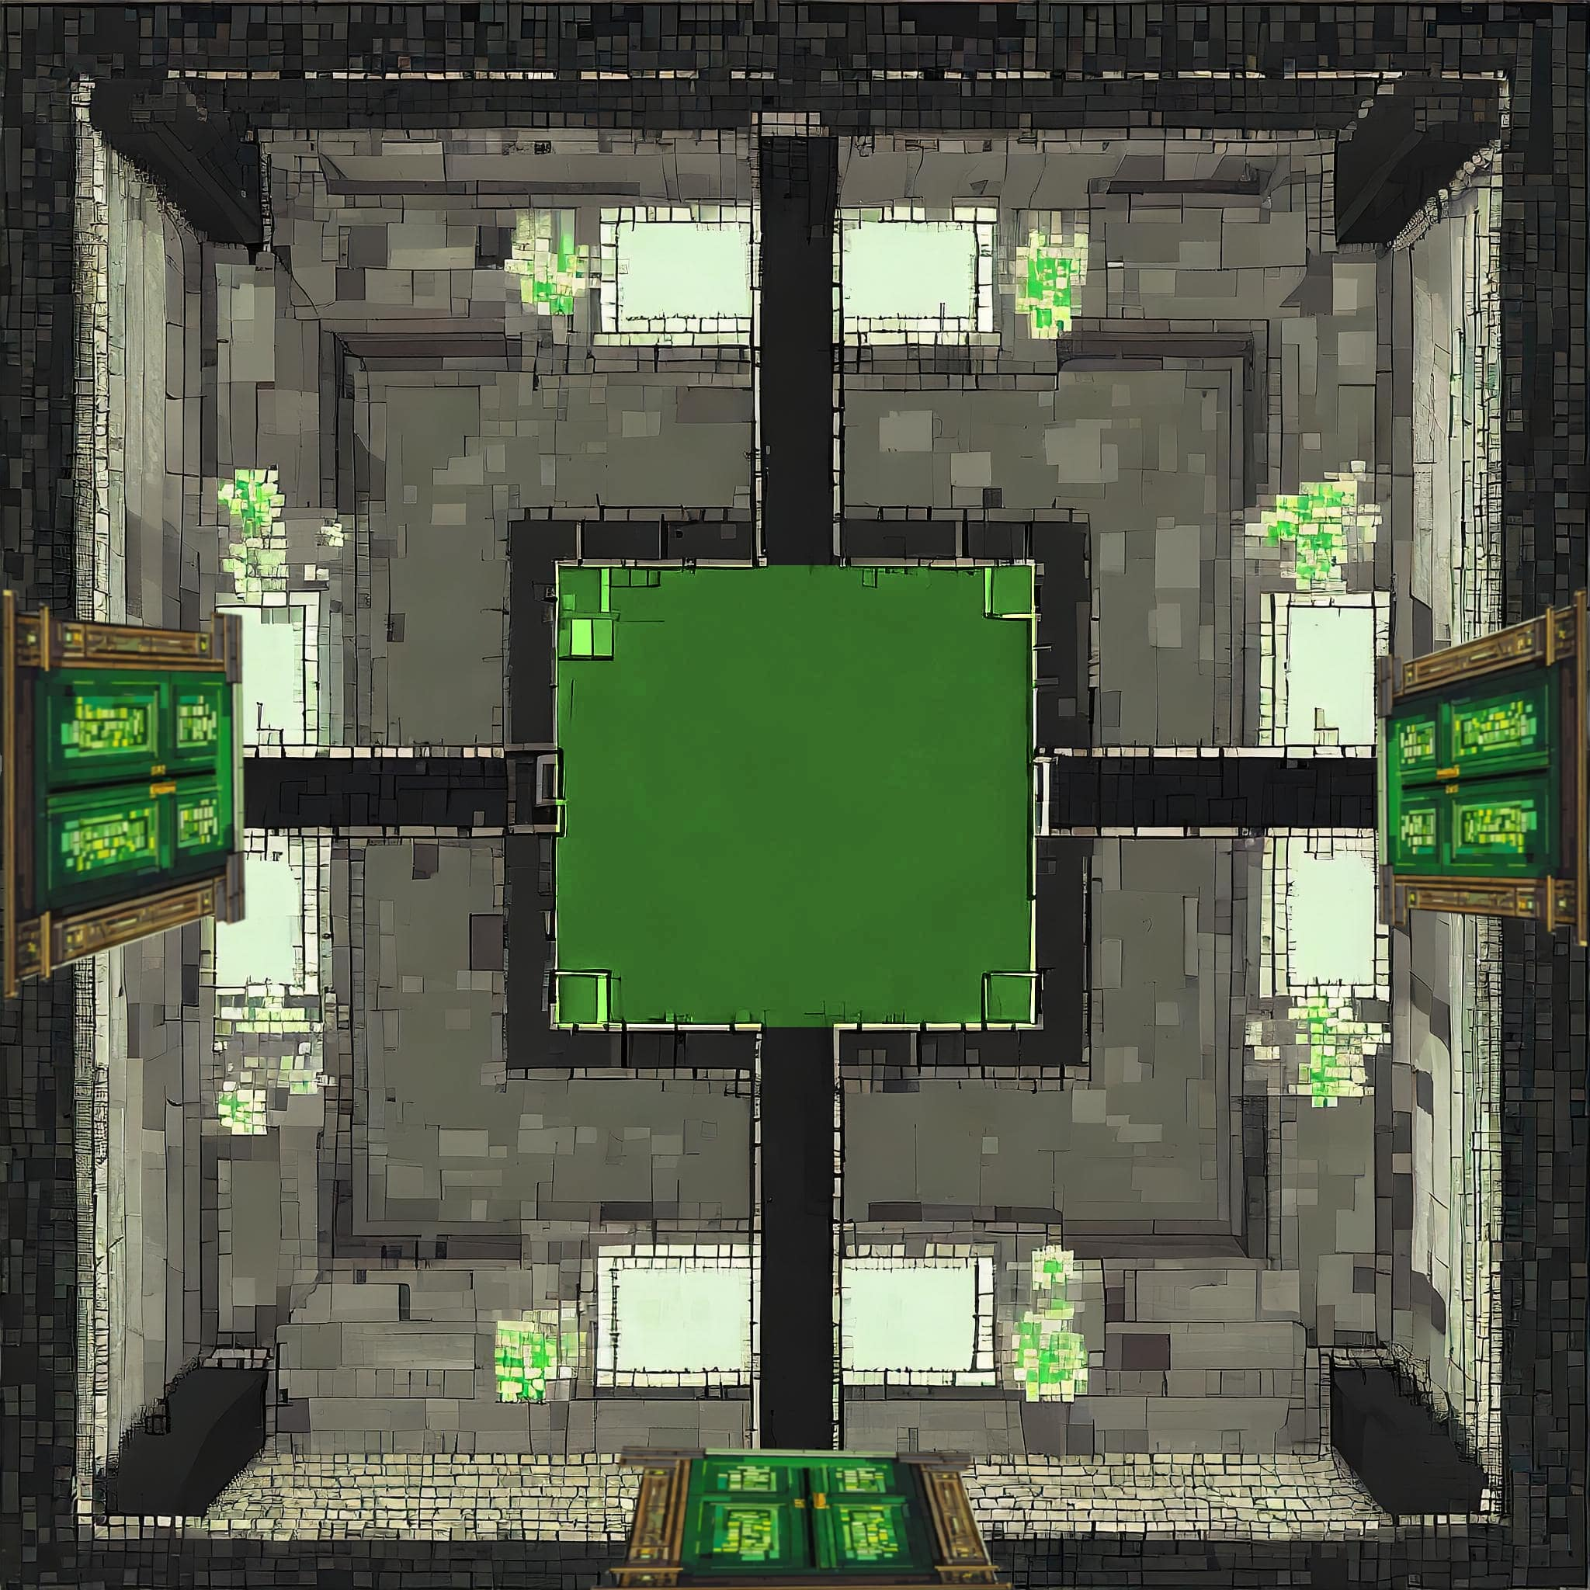
Rooms
Room Methods

Slide 5

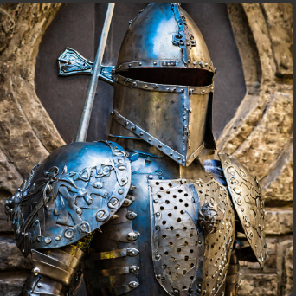
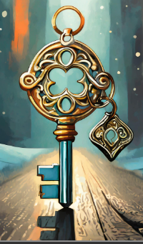
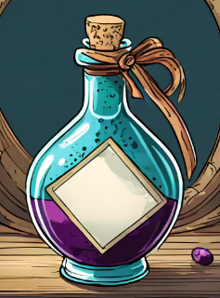
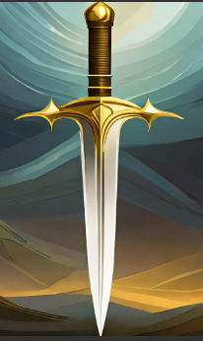
Player
Items
Key
Sword
Armor
Potions

Slide 6

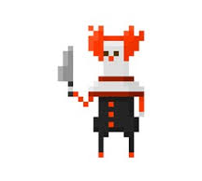
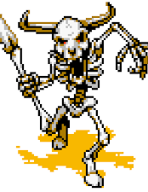
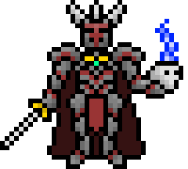
Entity
EnemyL1
EnemyL2
EnemyL3
EnemyL4

Slide 7

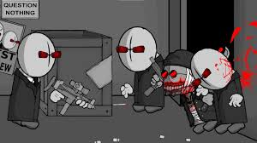
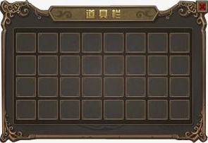
Windows
Game (Main)
Combat
Inventory

Slide 8

Problems

Slide 9
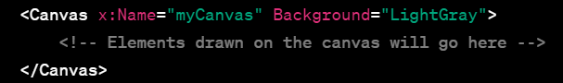
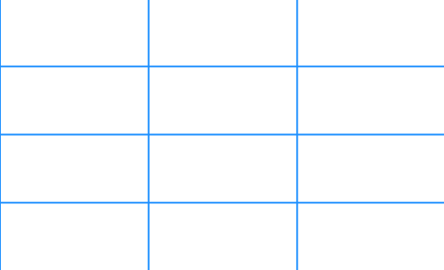
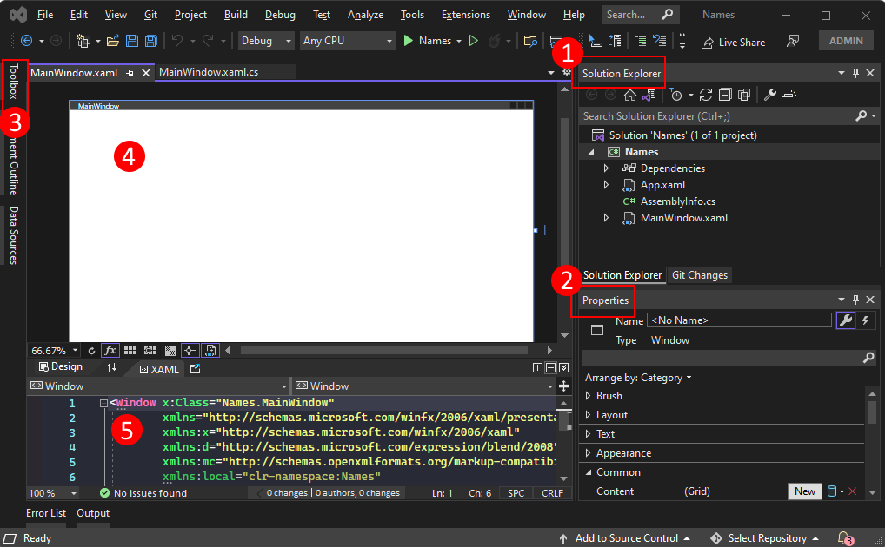

Canvas
Solution a Grid
Having different windows interact with each other
Having the classes interact with each other
Adding visual representation

Slide 10

Demo

Slide 11


Thank you

